Slide 1
Introduction to Database

Slide 2
Why databases?
Notes:
Why Do We Need Databases?
This is where I would slow down a little and make it practical.
“But here's the more interesting question: Why do we need databases in the first place?”
“If I only have five customers, I could probably keep their information in a spreadsheet. I could even write it down on paper.”
“But what happens when I have 5,000 customers? Or 5 million?”
“Now I have a problem.”
Problem 1 — Finding information
“Imagine a company has 100,000 customers and someone asks, ‘Show me every customer who placed an order in the last 30 days.’”
“You don't want an employee manually searching through thousands of records.”
“A database allows us to find specific information quickly.”
Problem 2 — Updating information
“Now imagine a customer moves and changes their address.”
“We don't want their old address sitting in five different places and someone having to remember to update all five.”
“A well-designed database helps us store information in a structured way and update it consistently.”

Slide 3


Today’s agenda
Define databases and database management systems (DBMS)
Explain the importance of databases in modern organizations
Distinguish between data and information
Identify problems associated with spreadsheets and text-file storage
Describe the roles of DDL, DML, and Query Languages
Explain the structure of relational databases using tables, rows, and columns
Describe the high-level database design process
Explain the purpose and importance of normalization

Slide 4
“What are some databases you interacted with today without necessarily realizing it?”
Notes:
Likely answers:
Instagram
TikTok
banking
Amazon
Netflix
Google
school registration
healthcare
Uber
Spotify
email
Almost every one of those systems needs to store and retrieve information about users, transactions, content, or activity.
“The interesting part of databases isn't just storing data. It's figuring out how to organize information so that a computer — and the people using it — can actually make sense of it.”

Slide 5
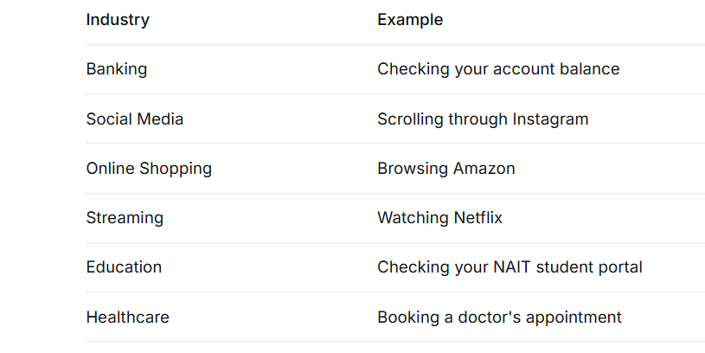

Slide 6
Data in Everyday Life
Organizations depend on data.
Data is used to maintain a business. For many businesses, the data IS the business.
What kinds of data might an organization need to store?
Business Type | Data They Store
Retail Store | Customers, Products, Orders, Employees
Bank | Accounts, Transactions, Customers, Loans
Hospital | Patients, Doctors, Appointments, Medical Records
University | Students, Courses, Instructors, Grades
Streaming Service | Users, Shows, Viewing History, Subscriptions

Slide 7
Data vs. Information
What's the difference between data and information?
DATA
Raw, unorganized facts or figures
Lacks context and meaning
The most basic form
Examples: 13, 15, 18
INFORMATION
Processed and organized form of data
Data that has been analyzed and given context
Provides meaning and can be used to answer questions
Examples: "The temperatures over the last three days are 13°, 15°, and 18°."
Key Point: Data + Context = Information

Slide 8
Quick Check
Which one is data? Which one is information?
"What makes something information rather than just data?"
A | B
42 | 42 students are enrolled in the class.
C | D
2026-09-02 | The assignment is due September 2, 2026.

Slide 9
What is a database?
Notes:
What is a Database? — Speaking Notes
“Before we get into all the technical terminology, let's start with a very simple question: What is a database?”
“When you hear the word database, you might immediately think of something complicated — servers, SQL, tables, code. But at its most basic level, a database is simply an organized collection of data.”
“The important word here is organized. We don't just want to have a huge pile of information. We want that information stored in a way that allows us to find it, update it, manage it, and use it.”

Slide 10
What is a Database?
A database is an organized collection of data.
That's it. But the organization matters.
Examples of data stored in databases->
"So, is an Excel spreadsheet a database?"
Type | Examples
Customer Information | Name, Address, Phone Number
Products | Description, Price, Quantity
Orders | Order Date, Customer, Total
Employees | Name, Position, Salary
Student Records | ID, Name, Grades, Courses

Slide 11
Why Not Just Use Excel?
For small amounts of similar data, a spreadsheet works fine. But what happens when the data grows?
Scenario:
10 customers → 1,000 customers → 1,000,000 customers
Now consider:
Multiple people need to edit the data
Data needs to be secure
Information must stay accurate
The same information appears in multiple places
People need to find information quickly
Question: "At what point does a spreadsheet become a problem?"
Notes:
familiar example
“Let's say I have a list of 10,000 customers.”
“For each customer, I might have their customer number, first name, last name, address, phone number, email, and maybe their order history.”
“That information is data. If I organize and store it so that I can efficiently work with it, I have a database.”

Slide 12
Problems with Spreadsheets
Storing data is easy. Managing data well is harder.
Problem | Explanation
Size | A little data tends to grow into a lot more.
Updating | What if many people need to work with the data at the same time?
Accuracy | Is there something to prevent incorrect data being entered? Not usually in a spreadsheet.
Security | Who gets to view certain data? What mechanisms ensure only authorized people access it?
Redundancy | Is the data stored in only one location? Having data in many places leads to maintenance problems.
Importance | Data is important. It can be the entire business, and it must be maintained properly.

Slide 13
The Problem with Redundancy
A Simple Example: Imagine we store the same customer in three spreadsheets:
Sales.xlsx
Joan Adams — 780-488-8712
Shipping.xlsx
Joan Adams — 780-488-8712
Support.xlsx
Joan Adams — 780-555-1234
Which phone number is correct?
"How did this happen?"
"What if Joan changes her phone number?"
"Wouldn't it be better if we stored Joan's phone number in one place?"

Slide 14
What Makes a Database Useful?
A good database allows data to:
Quality | Description
Grow | without becoming unmanageable
Stay accurate | through rules and constraints
Stay consistent | without unnecessary duplication
Stay secure | by controlling access
Be accessible | to the people and applications that need it
It's not just about placing data somewhere. It's about making data maintainable, secure, accurate, and appropriately accessible.

Slide 15
Databases Are Everywhere
Why are databases important?
Data is used to maintain a business
For many businesses, data IS their business
Good database skills are valuable for years or decades
Fundamental database concepts have been tested for decades and are very solid
What happens behind the scenes?
Much of what is involved with a database is created behind the scenes. Users only see how well it works. All the good stuff is invisible!

Slide 16
How Can We Organize Data?
Imagine we have this information:
Customer #100
Joan Adams
9825-77 Ave
Edmonton
Alberta
T5C 8E2
780-488-8712
That's useful information. But imagine having 10,000 customers. We need a consistent way to organize it.
A relational database organizes data into tables.

Slide 17
The Relational Database
A relational database stores data in tables.
Key Terms:
Term | Definition | In this example
Table | Stores information about a particular subject | Customer table
Row | One individual record | Each customer's row
Column | One type of information | Customer Number, Last Name, etc.

Slide 18
The Relational DBMS
Customer Number | Last Name | First Name | Address | Phone
100 | Adams | Joan | 9825-77 Ave Edmonton Alberta T5C 8E2 | 780-488-8712
200 | Smith | Miles | 4308-133 Ave Edmonton Alberta T5C 8E9 | 780-438-9523
Notes:
“This is a very simple example of what data might look like inside a relational database. We have rows representing individual customers, and columns representing the different pieces of information we store about them.”

Slide 19
Anatomy of a Table
Let's label the parts. We will use these terms throughout the course.
Customer Number | Last Name | First Name | Address | Phone
100 | Adams | Joan | 9825-77 Ave Edmonton AB T5C 8E2 | 780-488-8712
200 | Smith | Miles | 4308-133 Ave Edmonton AB T5C 8E9 | 780-438-9523
Term | Definition
Column | One piece of information about a customer (attribute)
Row | A collection of information for one specific customer (record)
Table | A collection of related records

Slide 20
What Makes a Database "Relational"?
A relational database doesn't just store isolated tables.
It allows us to connect related information.
Question:
"How do we know which customer placed Order 501?"
Answer: Because the tables contain a connection through Customer #.
A relational database stores information in related tables.
CUSTOMER |  | ORDER
Customer # | Name | Order # | Date | Customer #
100 | Joan Adams | 501 | Sept. 3 | 100
200 | Miles Smith | 502 | Sept. 5 | 100
 |  | 503 | Sept. 6 | 200

Slide 21
Database vs. DBMS
This distinction is important.
Examples of DBMS:
DATABASE | DBMS
Stores the data | Manages and provides access to the database
The data and the rules | The software that allows us to interact with the data
DBMS | Description
PostgreSQL | Open-source, powerful
SQLite | Lightweight, embedded
Oracle | Enterprise, large-scale
SQL Server | Microsoft's DBMS
Key Idea: You don't normally walk up to the database and talk to it directly. You make a request to the DBMS, and the DBMS handles the work.

Slide 22
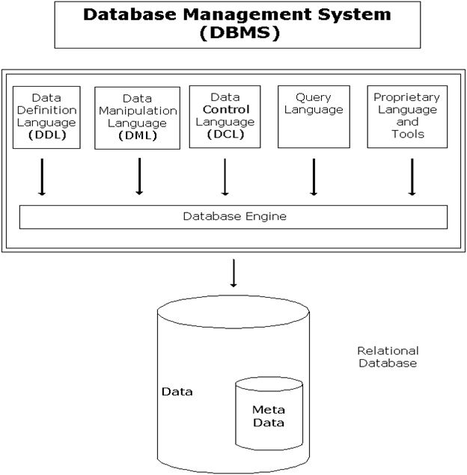
Notes:
Transition to DBMS
Now you can move naturally to the first diagram:
“But there's an important distinction we need to make.”
“A database is where the data is stored.”
“A DBMS, or Database Management System, is the software that allows us to create, manage, access, and work with that data.”
“Think of the database as the organized collection of information, and the DBMS as the system that lets us interact with it.”
You can give them a simple analogy:
“If the database is the library's collection of books, the DBMS is the system that lets you catalog the books, search for a book, check it out, update information, and manage who has access to it.”
“And that's what we're going to be learning how to work with in this course.”

Slide 23
How Do We Interact With a Database?
Four Ways We Work With a Database:
Language | What does it do?
DDL (Data Definition Language) | Defines the database structure (metadata)
DML (Data Manipulation Language) | Creates and manipulates data
DCL (Data Control Language) | Controls access and security
Query Language | Retrieves data from the database

Slide 24
Think of It This Way
Simple way to remember:
Language | Think of it as...
DDL | "Build the structure."
DML | "Change the data."
DCL | "Who is allowed to do what?"
Query | "Give me the information I need."
Developers and users do not interact directly with the database. Instead, they submit requests to the DBMS. The DBMS responds to requests and performs the tasks involved in creating, changing, and using a database.

Slide 25
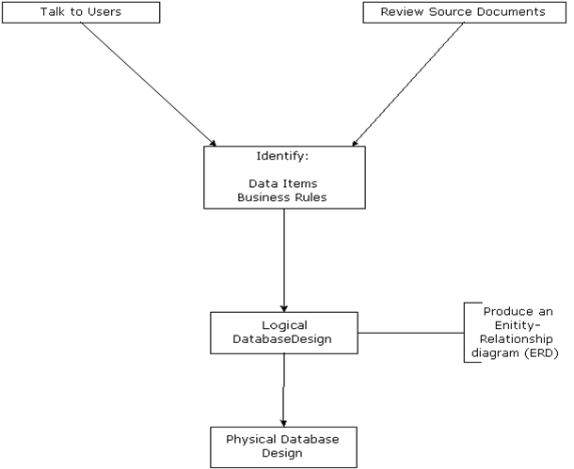
The Database Design Process
Before designing the database, we need to understand:
What is the database for? (Purpose)
What data needs to be stored?
What functions will the database support?
How do we find this out?
Talk to users to identify requirements
Review source documents (reports, forms, screen layouts)

Slide 26
Business Rules
What are business rules?
A statement that defines or constrains some aspect of the business.
Examples:
Business Rule | Why It Matters
An employee cannot work in two departments at the same time | Prevents scheduling conflicts
A student's grade must be between 0 and 100 | Ensures data validity
An order cannot be shipped to an address not in the customer's profile | Maintains data consistency
An order must have at least one item | Enforces business requirements
The database design must account for these rules.

Slide 27
What is an Entity?
An entity is something about which we want to store information. Also called an entity class or entity type
Think: "What is the 'thing' we're keeping track of?"
Examples:
Industry | Entities
University | STUDENT, COURSE, INSTRUCTOR, PROGRAM
Retail | CUSTOMER, PRODUCT, ORDER, EMPLOYEE
Bank | ACCOUNT, CUSTOMER, TRANSACTION
Gym | MEMBER, CLASS, INSTRUCTOR
Remember: Entity = what we're storing information about

Slide 28
What is an Attribute?
An attribute is a characteristic or piece of information about an entity.
When stored in a table, an attribute becomes a column
Example: STUDENT Entity
Attribute | Description
Student ID | Unique identifier
First Name | Student's first name
Last Name | Student's last name
Email | Student's email address
Date of Birth | Student's birth date
Remember:
Entity = what we're storing information about
Attribute = information we store about it

Slide 29
Entities Can Be Related
Entities don't exist in isolation.
A STUDENT can ENROLL IN a COURSE
A CUSTOMER can PLACE an ORDER
An ORDER can CONTAIN a PRODUCT
Relationship = how two entities are connected
Entity | Relationship | Entity
CUSTOMER | → places → | ORDER
ORDER | → contains → | PRODUCT
STUDENT | → enrolls in → | COURSE
We'll explore relationships in more detail next class!

Slide 30
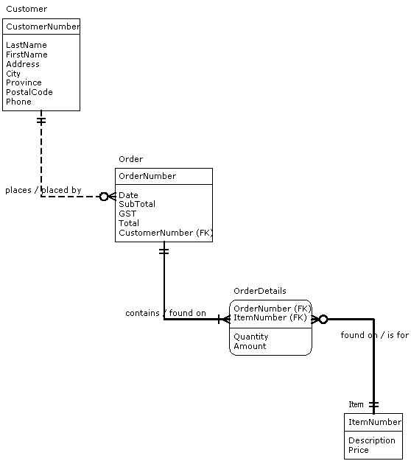
EXPLORING: What is an ERD?
How do we represent all of this visually?
ERD = Entity-Relationship Diagram
A visual representation of the entities, attributes, and relationships within a database
Think of it as a blueprint for the database
What it shows:
Entities (the things we store information about)
Attributes (the characteristics we store)
Relationships (how entities are connected)
Cardinality (how many instances can participate)

Slide 31
Sample ERD
Notes:
Problem 3 — Relationships between information
“And here's where databases become really useful.”
“Customers don't exist in isolation. Customers place orders. Orders contain products. Products have prices and descriptions.”
Point to the ERD:
“So instead of putting absolutely everything into one giant table, we can organize our information into related entities.”
“Here we have a Customer, an Order, and an Item. The database keeps track of how those pieces of information relate to one another.”
“That's where the word relational comes from. We're not just storing data — we're storing the relationships between pieces of data.”

Slide 32
Introduction to Normalization
Example of Inconsistent Data:
What is normalization?
Normalization is a set of guidelines for creating the logical design of a relational database.
It helps us decide:
How many tables do we need?
Which attributes belong in each table?
How should the data be organized?
Main Goal:
Reduce unnecessary redundancy and prevent inconsistencies.
Order | Customer | Phone
1001 | Joan Adams | 780-488-8712
1002 | Joan Adams | 780-488-8712
1003 | Joan Adams | 780-555-1234
Which phone number is correct?
Wouldn't it be better if we stored
Joan's phone number in one place?

Slide 33
Why Normalization Matters
Problems without normalization:
Problem | Example
Redundancy | Same data stored in multiple places
Inconsistency | Different versions of the same data
Update anomalies | Must update multiple locations
Insert anomalies | Can't add data without other data
Delete anomalies | Deleting one thing removes other data
Normalization helps ensure data remains:
  Consistent
  Accurate
  Efficiently organized
We'll cover this in detail in upcoming lessons.

Slide 34
Key Takeaways:
Concept | Summary
Database | An organized collection of data
DBMS | Software used to manage a database
Data vs. Information | Data = raw facts; Information = data with context
Relational Database | Data stored in related tables
Table | Collection of related records
Row | One record
Column | One type of information
Entity | A thing we store information about
Attribute | A characteristic of an entity
Relationship | How entities are connected
Normalization | Guidelines to reduce redundancy and inconsistencies

Slide 35
Terms You Will Encounter in This Course
Term | Meaning
Database | Organized collection of data
DBMS | Software to manage databases
Table | Collection of related records
Row | One record
Column | One piece of information
Entity | Thing we store information about
Attribute | Characteristic of an entity
Relationship | Connection between entities

